Slide 1
Understand code versioning using GitHub

Slide 2
AGENDA
What is Git?
Why to learn Git?
Some features of GitHub

Slide 3
What is Git?
Git is the world’s most popular version control system, but what does that mean? Let us take an example: While creating a project there are different files to save, it makes managing our files easier and the History. Where the word history means to get and keep the track of every change made to a project. Git can even tell the lines of code we added and which lines of code we removed; a great feature of history makes work easy.
When developers create something (an app, for example), they make constant changes to the code, releasing new versions up to and after the first official (non-beta) release

Slide 4
What is Git? (Cont.)
Git makes Collaboration very easy. Version control systems keep these revisions straight, storing the modifications in a central repository.
This allows developers to easily collaborate, as they can download a new version of the software, make changes, and upload the newest revision. Every developer can see these new changes, download them, and contribute.

Slide 5
What is Git? (Cont.)
Git has Feature Branches that helps to work on multiple features at once. Git is a command-line tool, but the center around which all things involving Git revolve is the hub—GitHub.com—where developers store their projects and network with like minded people.

Slide 6
Why to learn Git?
To bring a bit of structure and organization to your code learning Git is truly a must. Git is not only for developers, people who have nothing to do with development can also use and download files from Git.
It is a preferred version control system of most developers since it has multiple benefits like History, Collaboration, Feature Branches over the other systems available. It stores file changes more efficiently and ensure file integrity better.
To know more go to, the Git Basics page has a thorough explanation on how Git works.

Slide 7
Why to learn Git? (Cont.)
Let us go over a few of the main reasons that geeks like to use GitHub and learn some terminology along the way
Repository
Forking a Repo
Pull Requests
Social networking
Changelogs

Slide 8
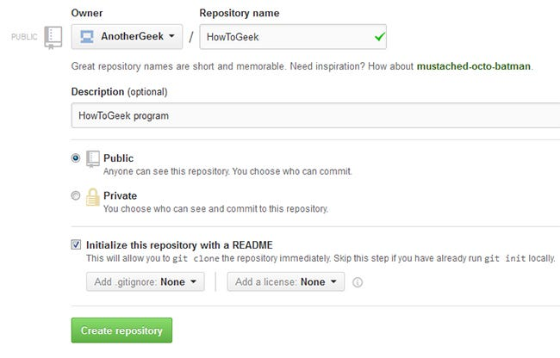
Why learn Git? (Cont.)
Repository
A repository (usually abbreviated to “repo”) is a location where all the files for a particular project are stored. Each project has its own repo, and you can access it with a unique URL.

Slide 9
Why learn Git? (Cont.)
Forking a Repo
“Forking” is when you create a new project based off another project that already exists. This is an amazing feature that vastly encourages the further development of programs and other projects. If you find a project on GitHub that you would like to contribute to, you can fork the repo, make the changes you’d like, and release the revised project as a new repo. If the original repository that you forked to create your new project gets updated, you can easily add those updates to your current fork.

Slide 10
Why to learn Git? (Cont.)
Pull Requests
You’ve forked a repository, made a great revision to the project, and want it to be recognized by the original developers—maybe even included in the official project/repository. You can do so by creating a pull request. The authors of the original repository can see your work, and then choose whether to accept it into the official project or not. Whenever you issue a pull request, GitHub provides a perfect medium for you and the main project’s maintainer to communicate.

Slide 11
Why learn Git? (Cont.)
Social Networking
The social networking aspect of GitHub is probably its most powerful feature, allowing projects to grow more than just about any of the other features offered. Each user on GitHub has their own profile that acts like a resume of sorts, showing your past work and contributions to other projects via pull requests.
Project revisions can be discussed publicly, so a mass of experts can contribute knowledge and collaborate to advance a project forward. Before the advent of GitHub, developers interested in contributing to a project would usually need to find some means of contacting the authors—probably by email—and then convince them that they can be trusted, and their contribution is legit.

Slide 12
Why learn Git? (Cont.)
Changelogs
When multiple people collaborate on a project, it is hard to keep track revisions—who changed what, when, and where those files are stored. GitHub takes care of this problem by keeping track of all the changes that have been pushed to the repository.

Slide 13
SUMMARY
What is Git? – History, Collaboration, Feature Branches
Why learn Git?
Features of GitHub
Repository
Forking Repo
Pull Requests
Social Networking
Changelogs
To learn more, go through the lab for getting started with GitHub

